Slide 1
Restaurant Order Analysis – World Cafe
Presented by Ruth Adikorley
Data source: Maven Analytics
Notes:
https://mavenanalytics.io/data-playground?order=date_added%2Cdesc&pageSize=10&search=restaurant%20orders

Slide 2
Agenda
Introduction
Building confidence
Engaging the audience
Visual aids
Final tips & takeaways

Slide 3
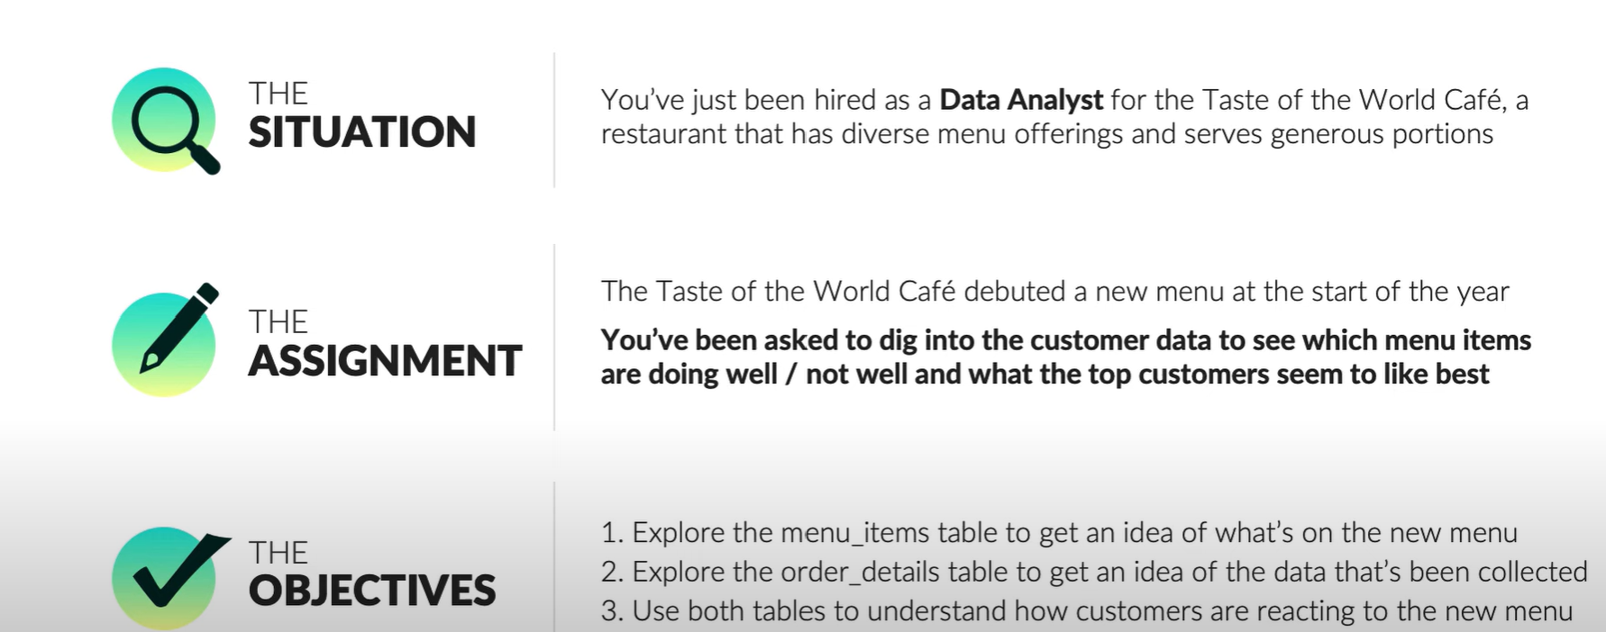
The project Objective
Notes:
https://www.youtube.com/watch?v=JaUKDbCXMX4
Data Analyst Portfolio Project: Restaurant Order Analysis in SQL (with Solutions)

Slide 4
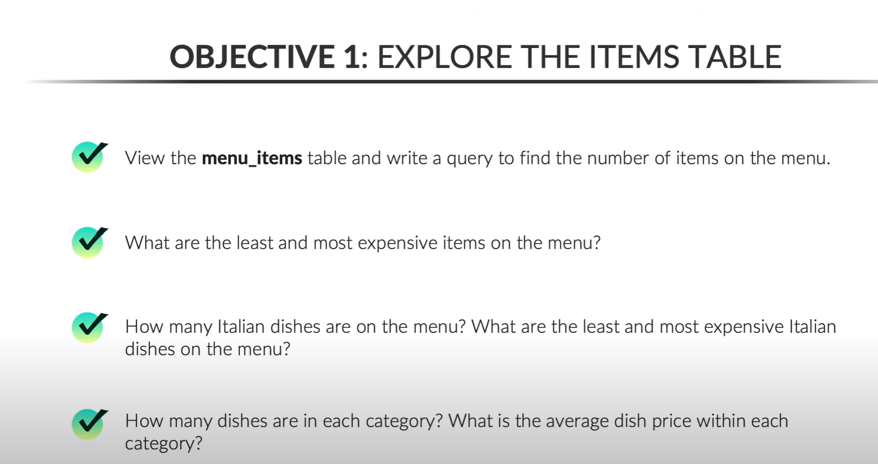

Slide 5
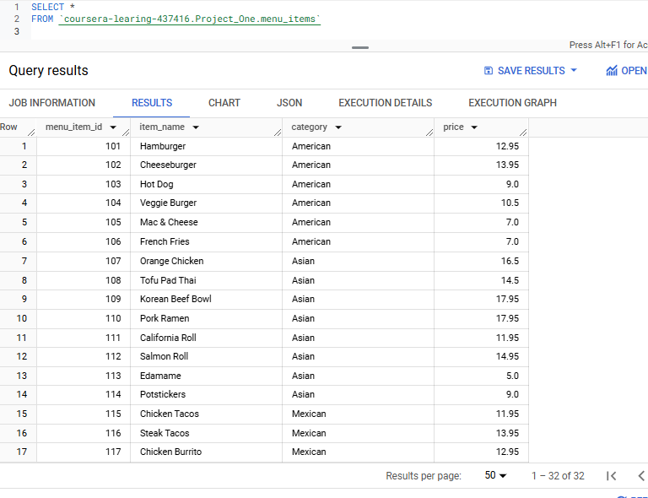
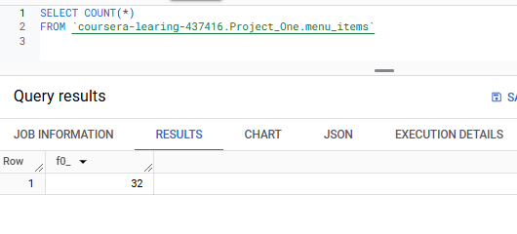
Objective 1: Explore the Items Table

Slide 6
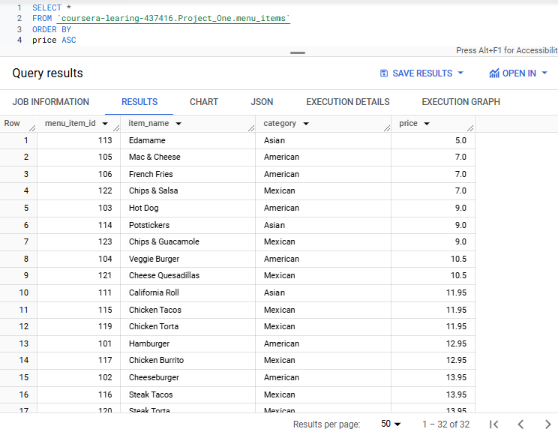
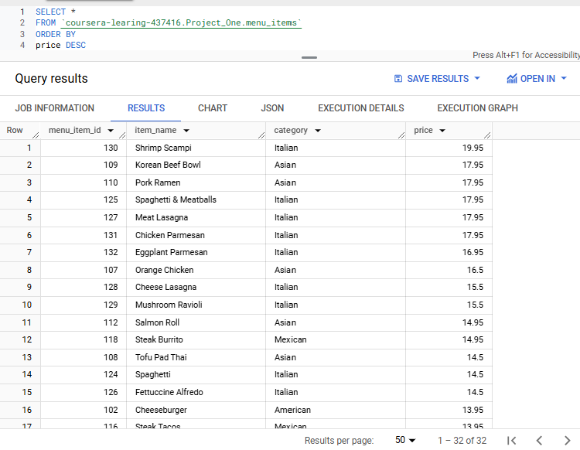
Objective 1: Explore the Items Table

Slide 7
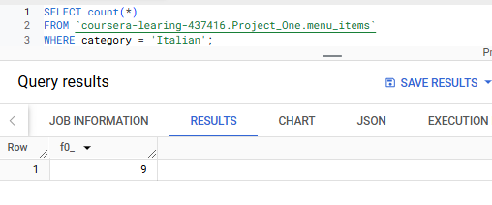
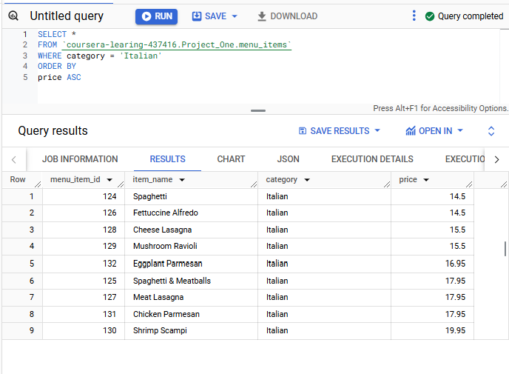
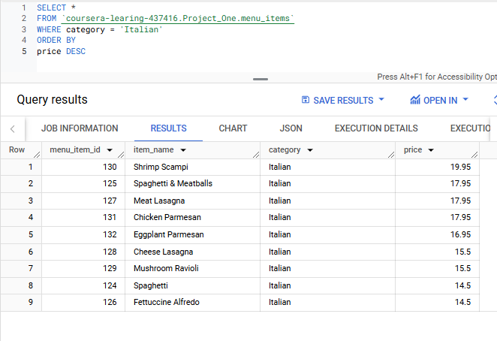
Objective 1: Explore the items table

Slide 8
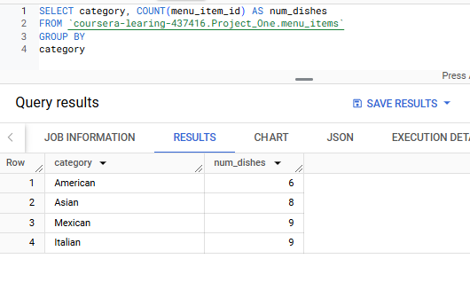
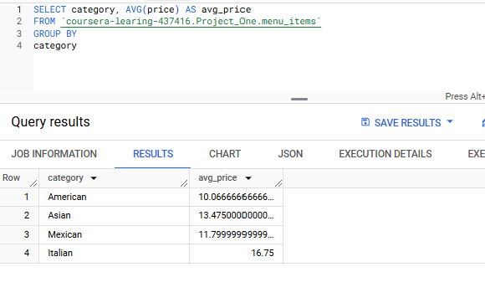
Objective 1: Explore the items table
The Mexican and Italian menu category has the most dishes
Italian foods are on average the most expensive items on the menu

Slide 9
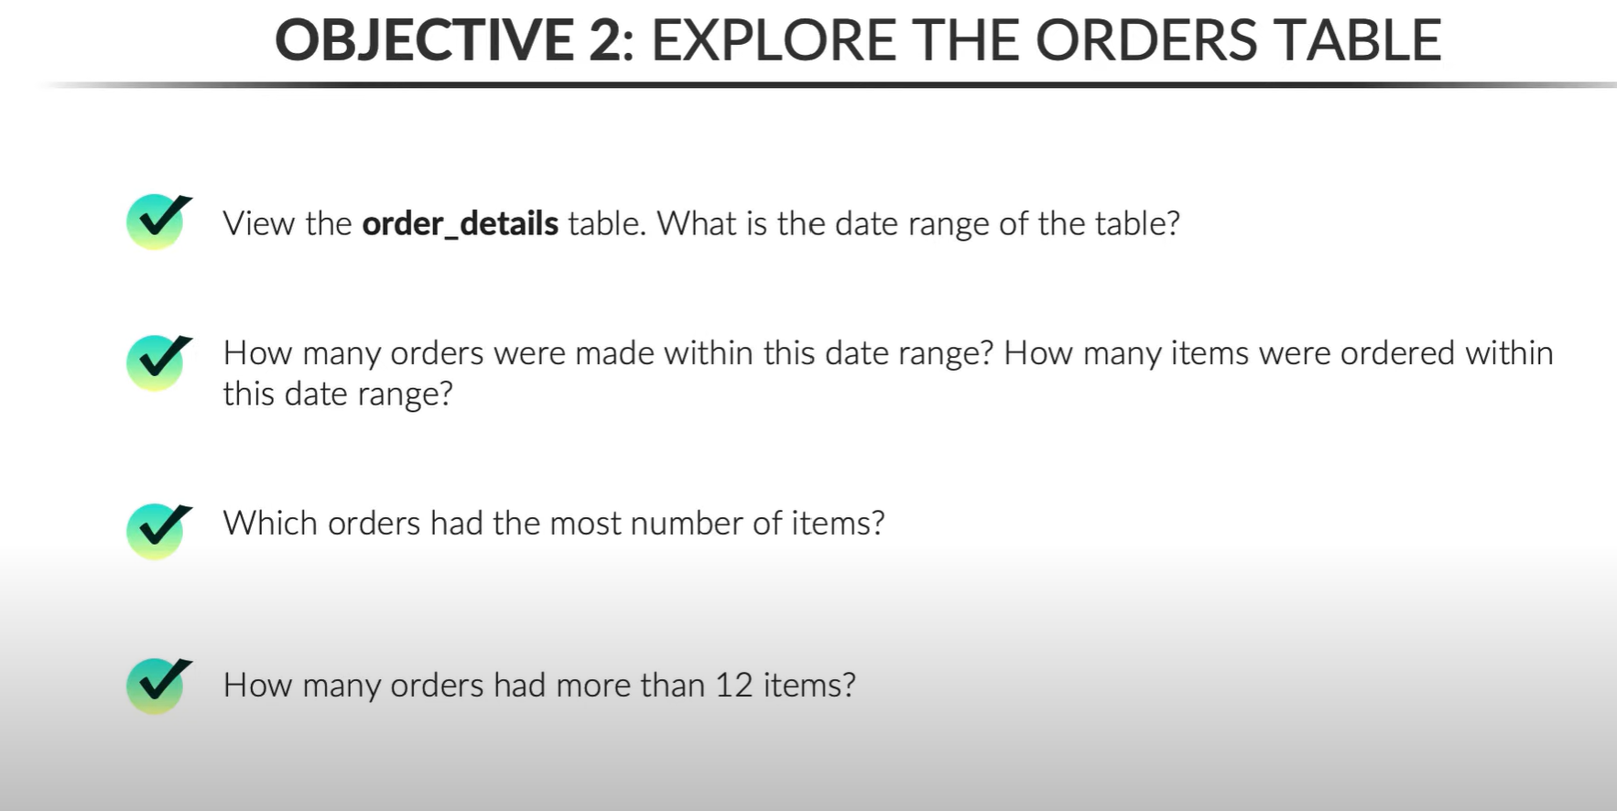
Objective 2:Explore the Orders Table

Slide 10
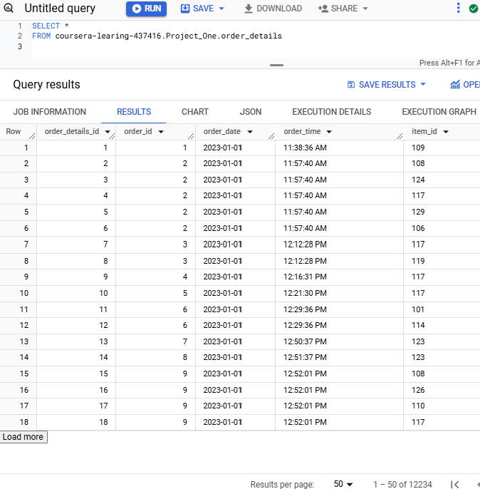
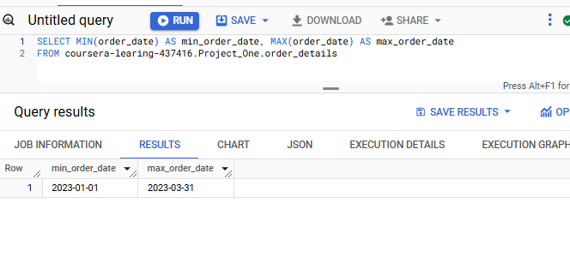
Objective 2:Explore the Orders Table

Slide 11
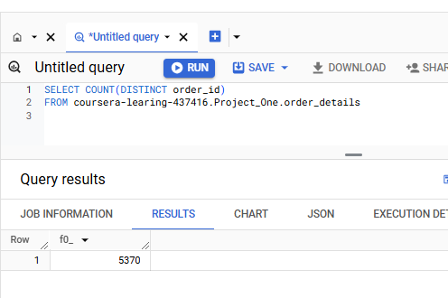
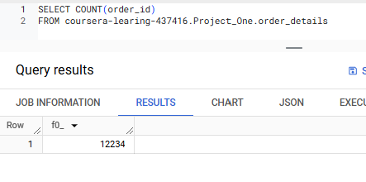
Objective 2:Explore the Orders Table
Between January 1, 2023, and March 31, 2023, there were 5370 orders placed, and 12,234 items ordered.

Slide 12
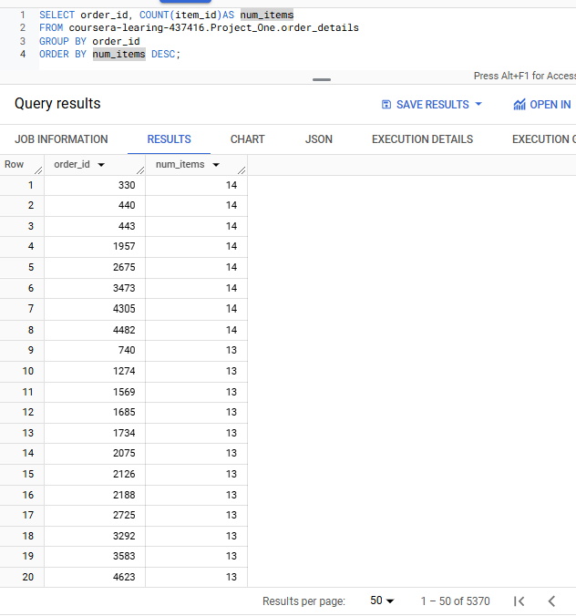
Objective 2:Explore the Orders Table

Slide 13
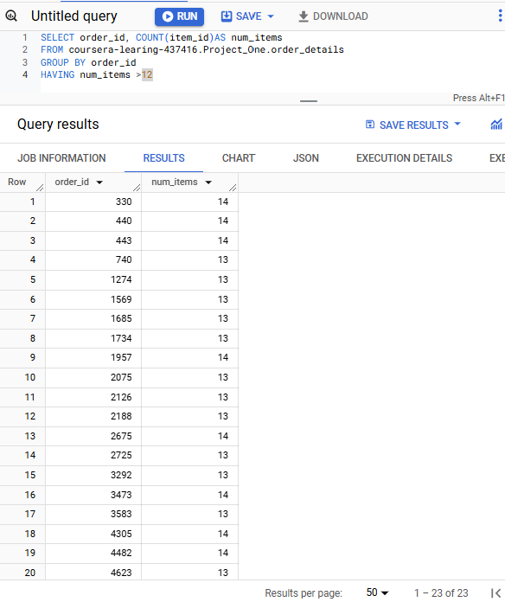
Objective 2:Explore the Orders Table
Notes:
What is

Slide 14
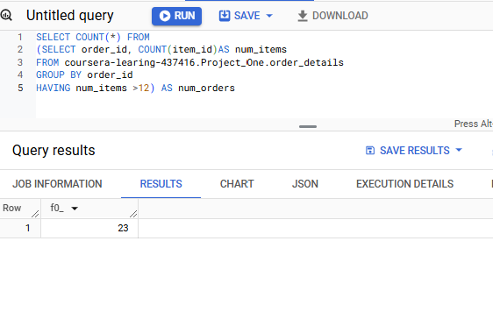
Objective 2:Explore the Orders Table

Slide 15
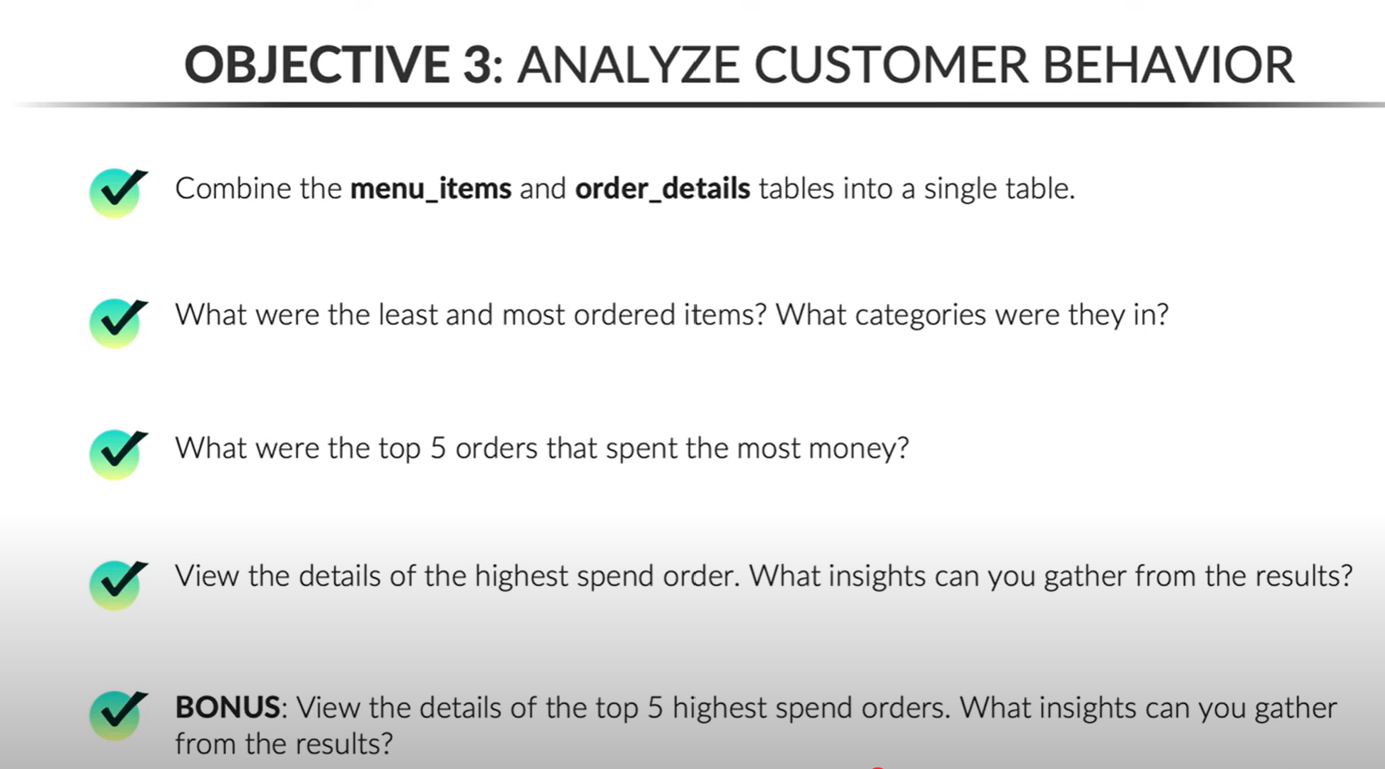
How are Customers reacting to the New Menu

Slide 16
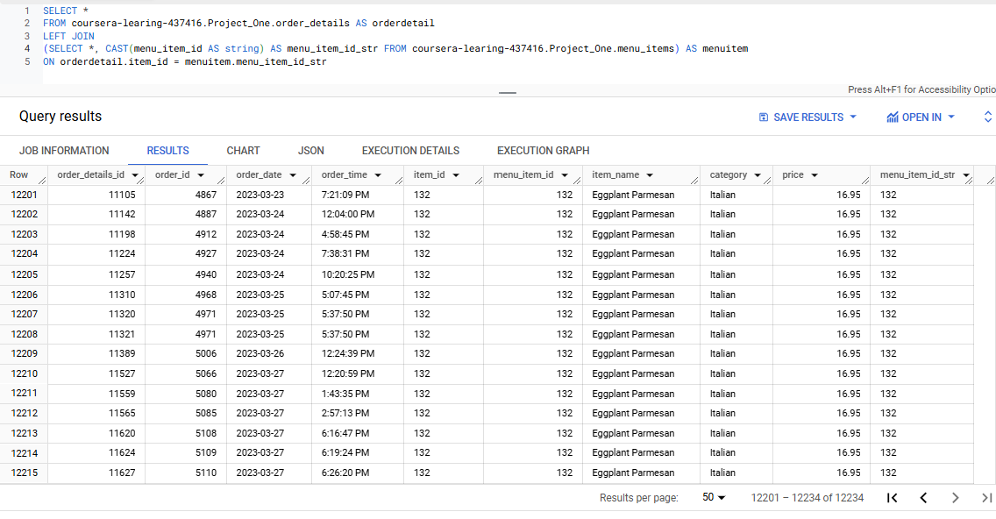
How are Customers reacting to the New Menu

Slide 17
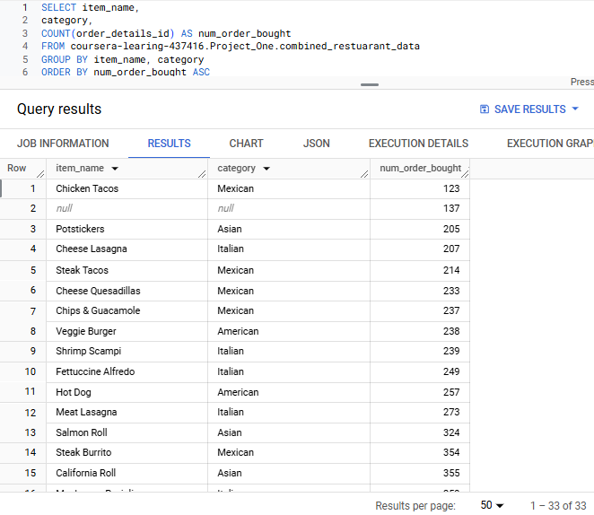
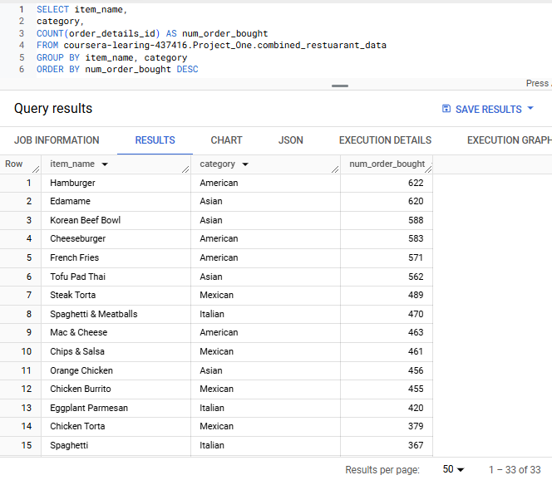
How are Customers reacting to the New Menu

Slide 18
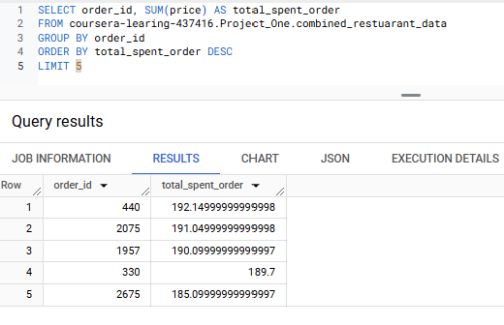
How are Customers reacting to the New Menu

Slide 19
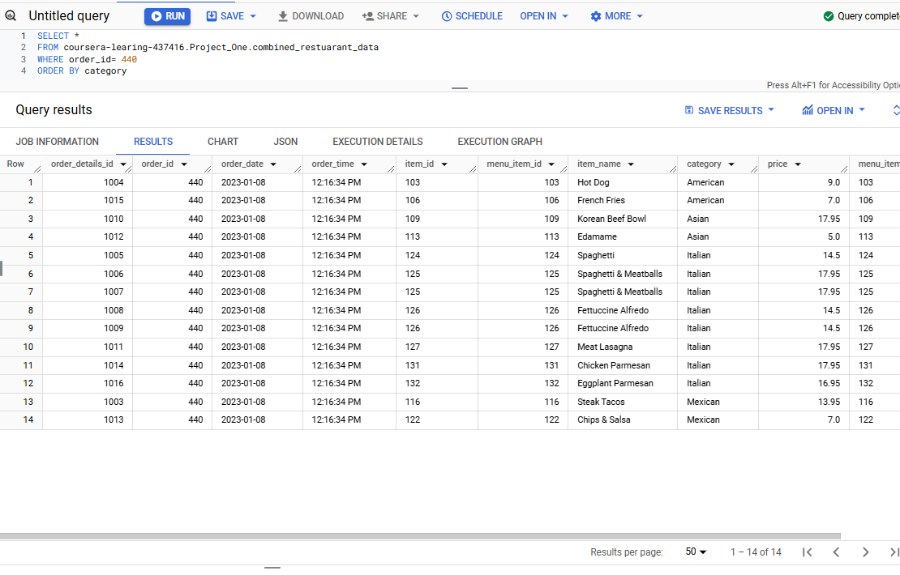
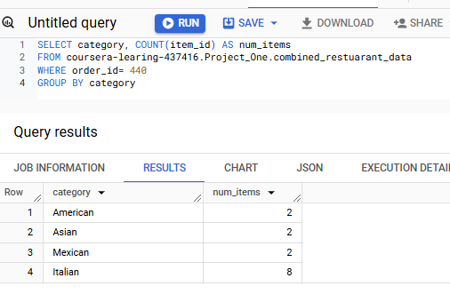
How are Customers reacting to the New Menu

Slide 20
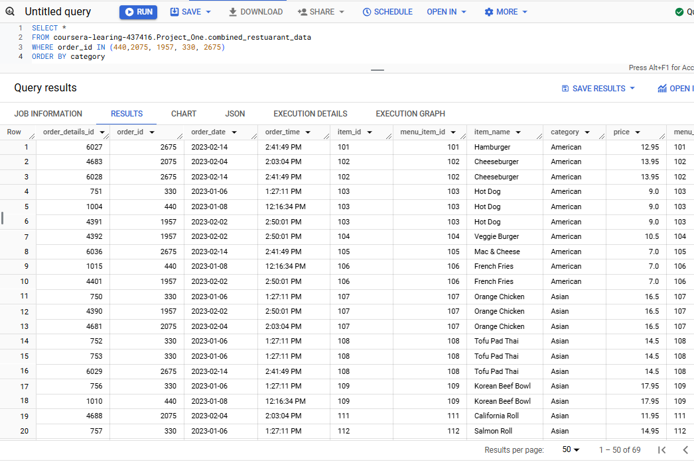
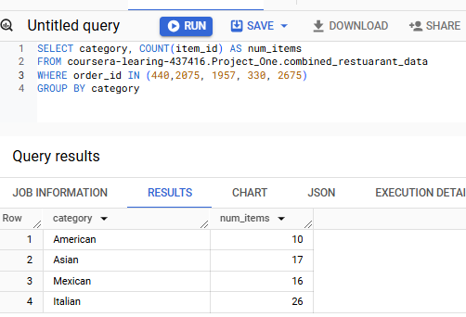
How are Customers reacting to the New Menu

Slide 21
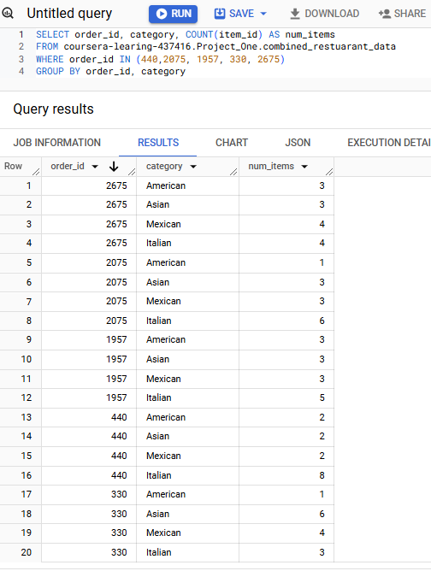
How are Customers reacting to the New Menu

Slide 22

Final tips & takeaways
In summary;
The top five orders were from the following categories:
Italian, Asian, Mexican, and American respectively.
Thee Italian and Mexican categories were to top revenue generating categories.
Hamburger was the most order item while Chicken tacos was the least order menu item.
Between January 1, 2023, and March 31, 2023, there were 5370 orders placed, and 12,234 items ordered.

Slide 23
Selecting visual aids
Enhancing your presentation

Slide 24
Navigating Q&A sessions
Know your material in advance
Anticipate common questions
Rehearse your responses
Maintaining composure during the Q&A session is essential for projecting confidence and authority. Consider the following tips for staying composed:
Stay calm
Actively listen
Pause and reflect
Maintain eye contact

Slide 25
Thank you
Ruth Adikorley
ruthadikorely@gmail.com
Data source: Maven Analytics

